Slide 1
Today
Admin notes
Review from last lesson
Machine learning primer
Appling ML techniques to viral cascade prediction

Slide 2
Machine Learning Primer
CSE 591: SEMANTIC WEB MINING

Slide 3
Some basic terms
Sample: an instance of something that you can take some observed measurements of and wish to infer something about
Example: a document
Data set: a set of samples
Example: a corpus of documents
Feature: something about a sample that can be measured
Example: Does the document have <a href=www.asu.edu> in it?
Example: How many times is the word “Sparky” in the document?
Feature set: a group of related features
Example: All features concerning the existence of hyperlinks in asu’s domain

Slide 4
Feature vectors
Lets suppose we have 5 measurements (a, b, c, d, e). So, a given sample can be represented as a vector:
< a, b, c, d, e >
A data set can then be easily represented as a matrix – a stack of the feature vectors for each sample.
We can imagine plotting samples as points in a “feature space.” Hence, the number of features is often called the “dimension”.
If we have 3 or fewer features, this can be easily drawn and understood by humans.
But, in reality, we usually have much more than 3 features – so this cannot be readily drawn.
Sometimes we use mathematical projections
In examples, we often use two features

Slide 5
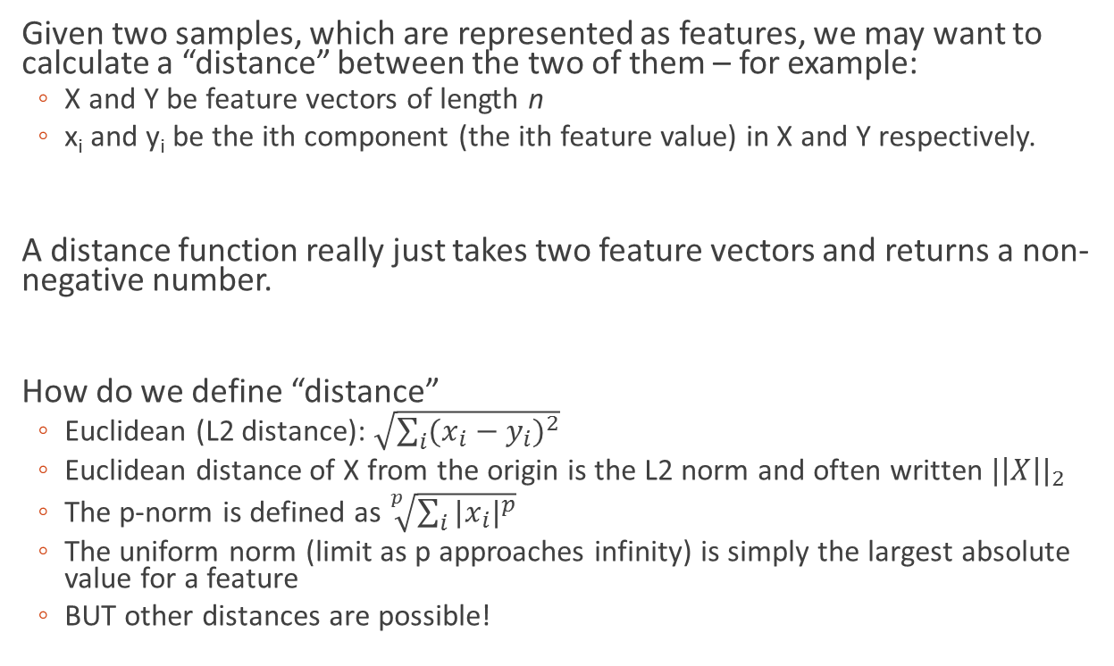
Distance Functions
Given two samples, which are represented as features, we may want to calculate a “distance” between the two of them – for example:
X and Y be feature vectors of length n
x_{i} and y_{i} be the ith component (the ith feature value) in X and Y respectively.
A distance function really just takes two feature vectors and returns a non-negative number.
How do we define “distance”
Euclidean (L2 distance): $\sqrt{\sum_{i}{{(x_{i}−y_{i})}^{2}}}$
Euclidean distance of X from the origin is the L2 norm and often written ${|\left|X\right||}_{2}$
The p-norm is defined as $\sqrt[p]{\sum_{i}{{|x_{i}|}^{p}}}$
The uniform norm (limit as p approaches infinity) is simply the largest absolute value for a feature
BUT other distances are possible!

Slide 6
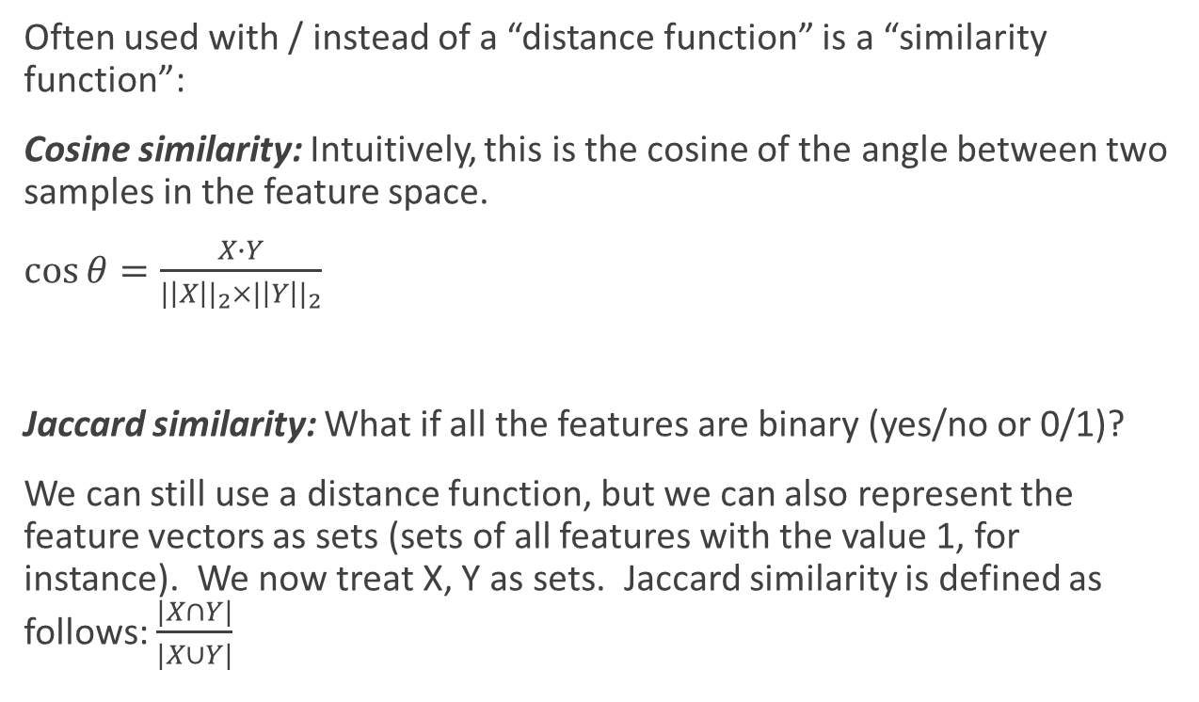
Similarity Functions
Often used with / instead of a “distance function” is a “similarity function”:
Cosine similarity: Intuitively, this is the cosine of the angle between two samples in the feature space.
$\cos{θ}=\frac{X∙Y}{{|\left|X\right||}_{2}×{|\left|Y\right||}_{2}}$
Jaccard similarity: What if all the features are binary (yes/no or 0/1)?
We can still use a distance function, but we can also represent the feature vectors as sets (sets of all features with the value 1, for instance). We now treat X, Y as sets. Jaccard similarity is defined as follows: $\frac{|X∩Y|}{|X∪Y|}$

Slide 7
Two types of ML
Unsupervised
Analyze a current set of data as it is
Supervised
Analyze a current set of data based on past data

Slide 8
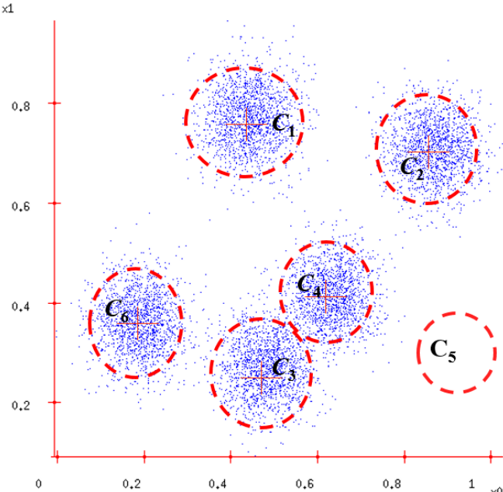
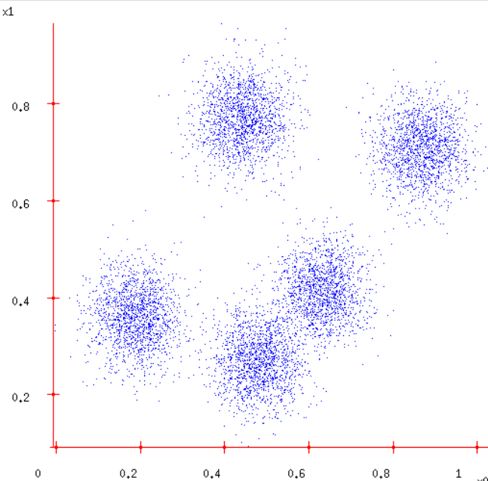
Example: Unsupervised
Consider samples plotted to the right (perhaps the two features here are latitude and longitude).
We then want to automatically group them into K number of groups.
We’ll cover unsupervised learning more in another class.

Slide 9
Two types of supervised learning
Regression: See a new sample, need to computer some sort of numeric value (i.e. how many people will retweet this message?)
Classification: Can we identify some category or label (called a “class”) for a new sample?

Slide 10
Example: Supervised
Have a database of patients who have undergone different tests.
The patients in the database either had cancer or did not – and we know this information.
Based on this old information, we get a new patient, who has undergone the tests, but we don’t know if he/she has cancer (the target class).
We design a system that takes the database and reasons about the new person.

Slide 11
Example: Supervised
Step 1: Create the model.
We have a mathematical model in mind M, that has a few parameters that must be set.
For instance, y=mx+b is a model for a line and has two parameters (m and b) that if known, can produce a y value for a given x.
Take the database of patients (represented as matrix D of feature vectors).
So we now train the model by running an algorithm that finds a set of parameters for M that “best fits” D. Let us call this M_{D}.
Step 2: Use the model.
Given new patient X, we then need to use M_{D} to determine if X has cancer. This is usually much easier computationally then training the model.
“Patient X” is often referred to as “test” data
At the end of the day, machine learning is about using an algorithm (the training algorithm) that essentially creates a new algorithm (the model) which is then used to reason about new data.

Slide 12
So what could possibly go wrong?
Most supervised learning approaches assume that the feature values in the training data are distributed in the same manner as in the test data.
If the distribution is different, then approach will generally fail
Supervised learning assumes that the features have something to do with the target class.
i.e. predict the stock market based on a football game
If the mathematical model fit too tightly to the data (“overfitting”) then it will properly handle unseen samples (“generalization”)
We’ll get to these soon, but first lets look at some ways to do this.

Slide 13
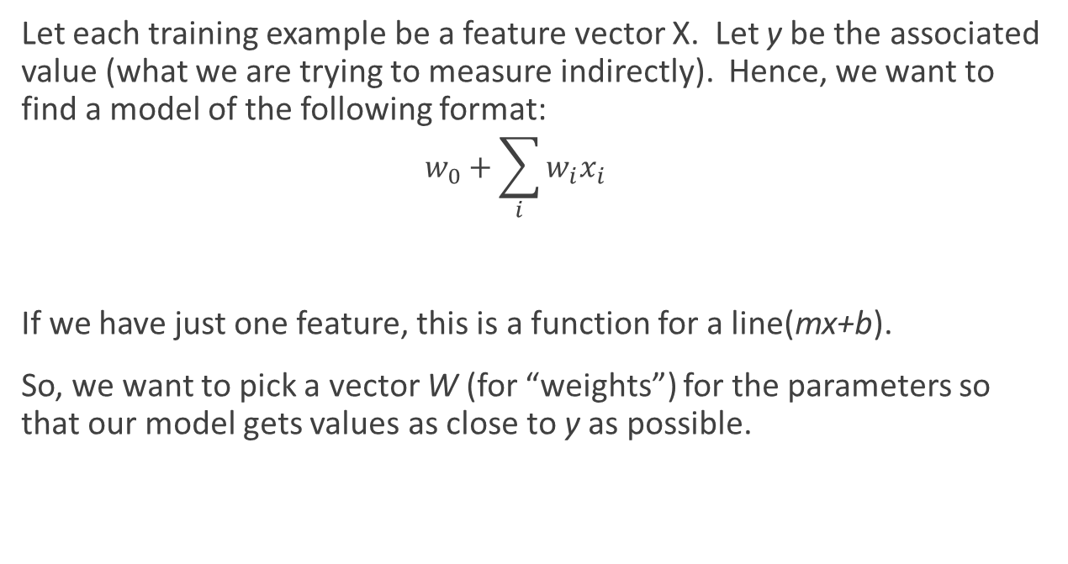
Regression
Let each training example be a feature vector X. Let y be the associated value (what we are trying to measure indirectly). Hence, we want to find a model of the following format:
$$w_{0}+\sum_{i}{w_{i}x_{i}}$$
If we have just one feature, this is a function for a line(mx+b).
So, we want to pick a vector W (for “weights”) for the parameters so that our model gets values as close to y as possible.

Slide 14
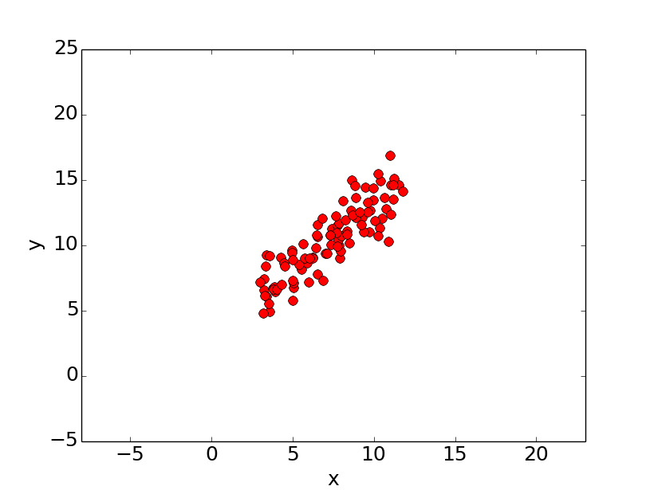
Linear Regression

Slide 15
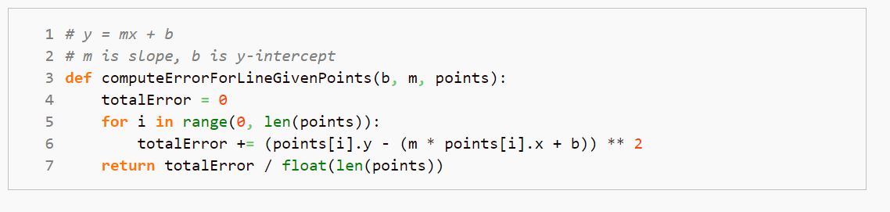
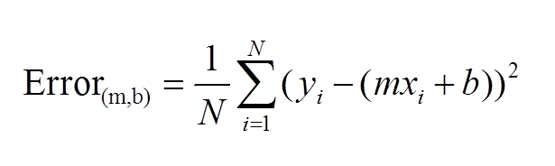

Slide 16
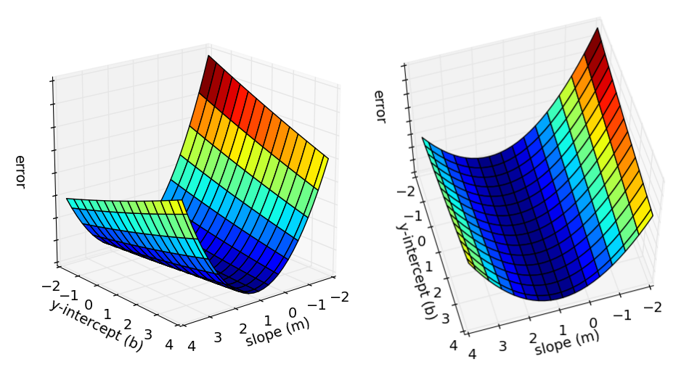

Slide 17
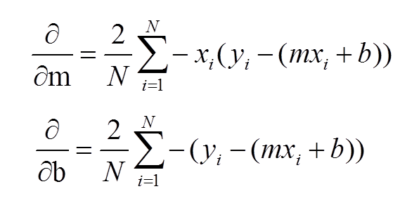
Partial Derivatives of the Error w.r.t. each model parameter

Slide 18
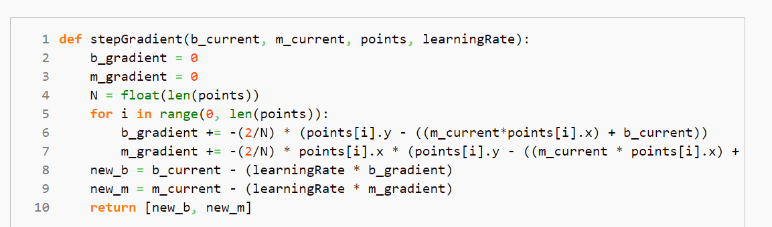

Slide 19
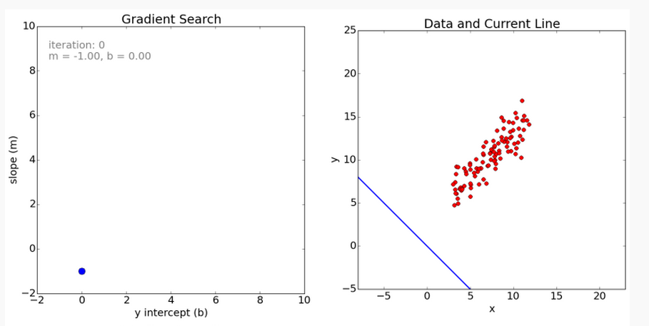

Slide 20
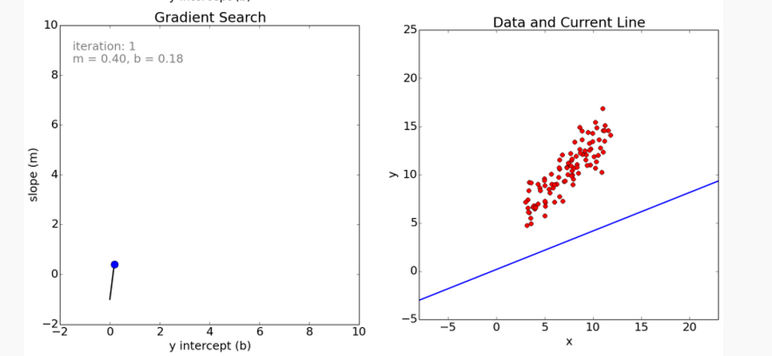

Slide 21
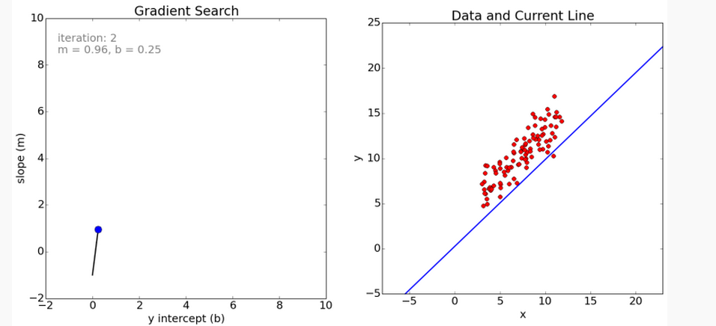

Slide 22
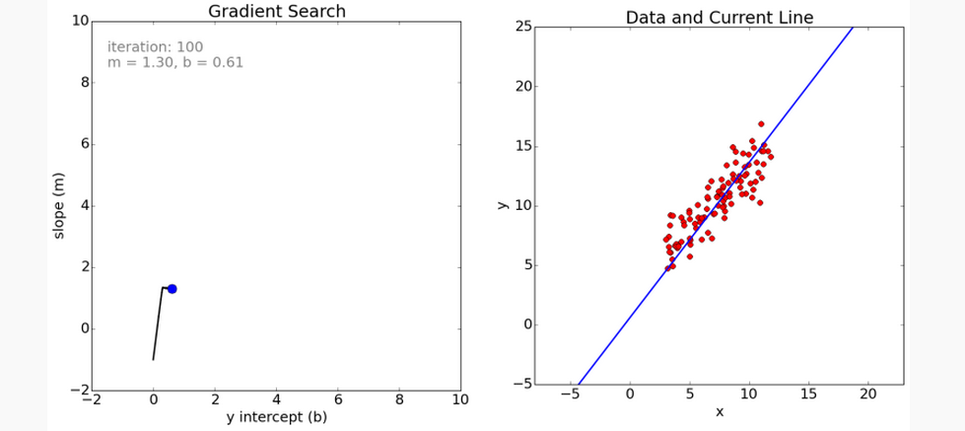

Slide 23
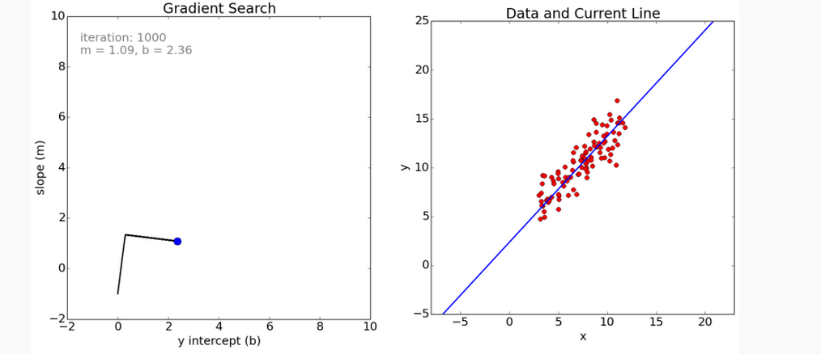

Slide 24
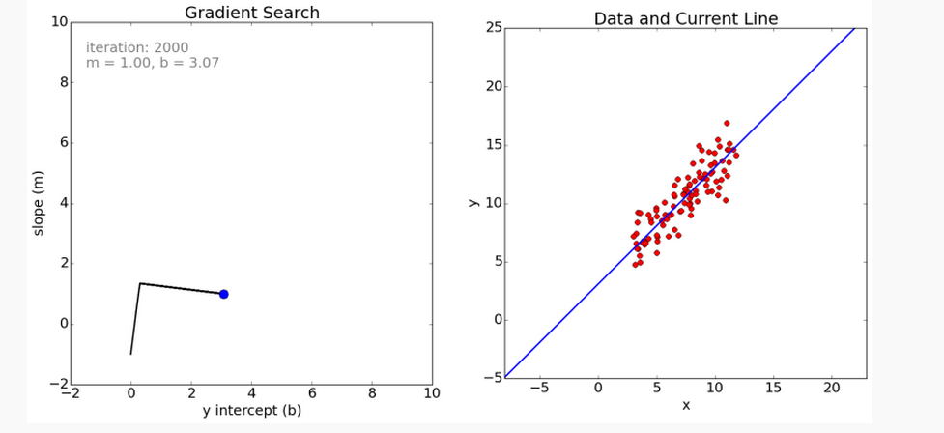

Slide 25
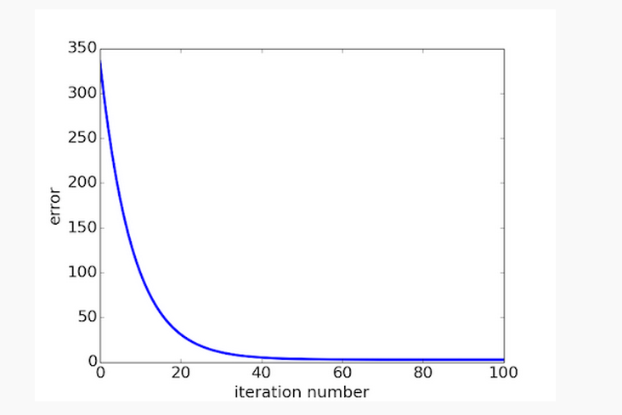

Slide 26
Classification
It may occur to use the same approach for regression for classification. Here y would simply be zero or one.
In this case, you would want to enforce a threshold.
However, gradient descent doesn’t work as well as the gradient is either zero or undefined. However, a modification is possible (perceptron)

Slide 27
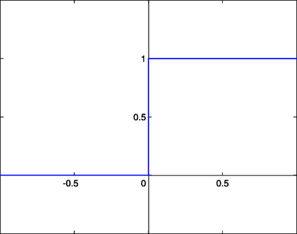
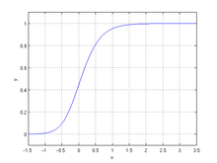

Logistic Regression
But a better way to go about doing business is to use a logistic function. Consider the following:
This function is continuous and differentiable, so gradient descent works much better here.
$${\frac{1}{{1+e}^{−\sum_{i}{w_{i}x_{i}}}}}^{}$$
Threshold Logistic

Slide 28
Other commonly used classification techniques
Decision tree (NYU slides)
Naïve Bayes (simple method, strong independence assumption)
Random forest (Bagging, boosting, parallelizable)
SVM (Generalizability, maximum-margin separator, kernel functions)
Neural networks and deep learning (not covered in this course)

Slide 29
Key Questions
Can we predict when a trend in social media will “go viral”
Create a regression model, based on features, predict the size of the cascade
Identify which Tweets will be re-tweeted over 1000 times
Predict when an existing information cascade will double in size

Slide 30
General Argument Against Maximum Influence
Influence maximization (in all models studied thus far) makes the assumption that the model is realistic and we can select nodes to optimize spread (seed or target set) based on that model.
Great results have been shown analytically and in simulation, but perhaps the models are too far away from reality to be useful (i.e. building an airplane without considering drag).

Slide 31
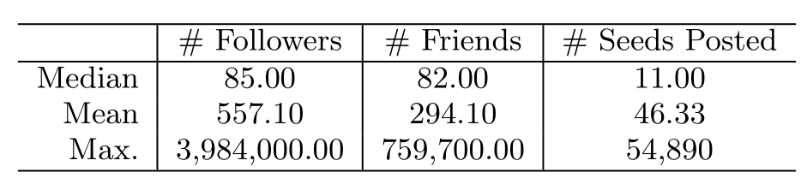
Empirical Study on Twitter (2011)
Subgraph of twitter 56M nodes, 1.7B edges
75M Tweets
Studied the propagation of shortened “bit.ly” URL’s

Slide 32
Large Cascades are Rare
Our study on a Sina Weibo dataset (17.9M users, 22M Tweets) confirmed the previously-observed power-law relationship between cascade size and frequency
Hence, when viewed as a classification problem, the classes are highly imbalanced
Guo, R., Shaabani, E., Bhatnagar, A., Shakarian, P., “Toward Order-of-Magnitude Cascade Prediction in Social Networks,” ASONAM, 2015.

Slide 33
Which Features are Predictive?
Anecdotal evidence on cascades often ends up highlighting features that may be necessary but not sufficient. The problem stems from the relative rarity of large cascades.
The goal of Bakshy et al. (2011) was to accurately predict cascade size.

Slide 34
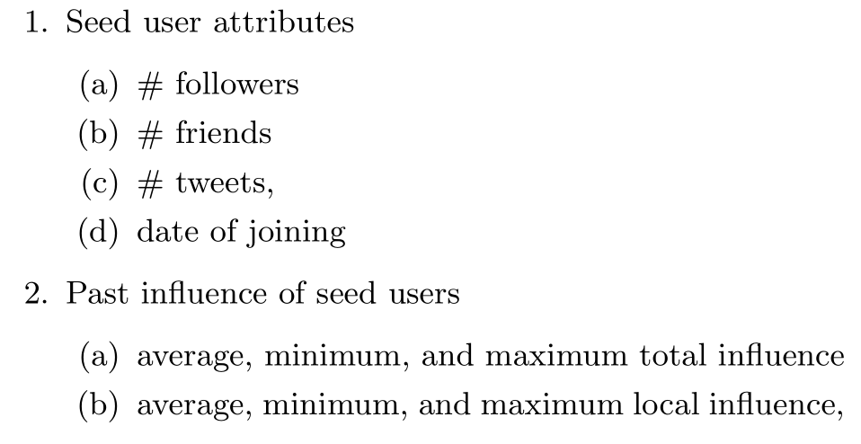
Features Used
Local – number immediate followers reposting information (within 1 month)
Global – total size of overall cascade

Slide 35
Classification Technique
Regression tree
Similar to a decision tree, but rather than identifying classes at the leaves, provides a regression function.
Bakshy et al. (2011) utilized a constant function (whose value is the mean of the data specified in a leaf)
Partitions determined greedily
Hence, the regression tree specifies a piecewise function
Multiple trees created using folded cross-fold validation to avoid overfitting

Slide 36
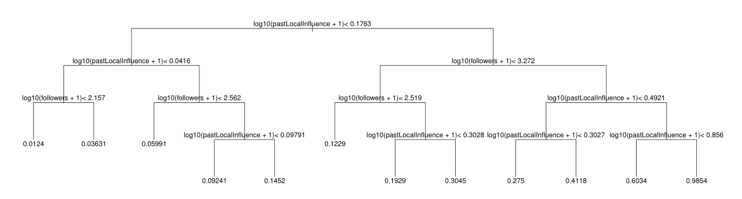
Classification Technique

Slide 37
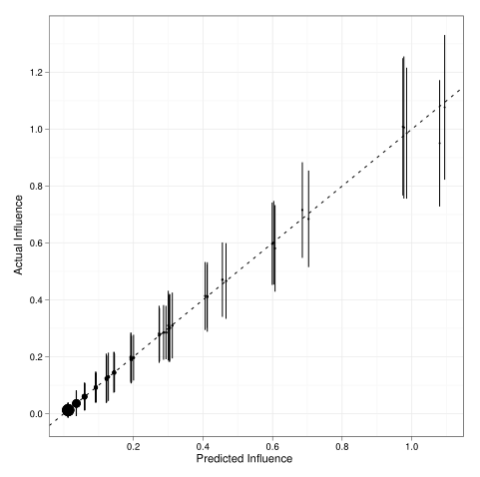
Comparison to Ground Truth
Data split into two 1-month periods (training and test)
Note that (due to the piece-wise function specified by the regression tree) that cascades are only predicted to have certain sizes.
The prediction for the average at each size fits the linear model well (R² = 0.98)
However, the overall fit is poor (R²=0.34)
Bakshy, Eytan, et al. "Everyone's an influencer: quantifying influence on twitter." Proceedings of the fourth ACM international conference on Web search and data mining. ACM, 2011.

Slide 38
Why the Poor Fit?
The regression tree revealed that past local performance and number of followers were indicative of future performance.
The authors point out that this is likely due to the large number of cascades of depth 1.
Again, note that the training data is highly skewed.

Slide 39
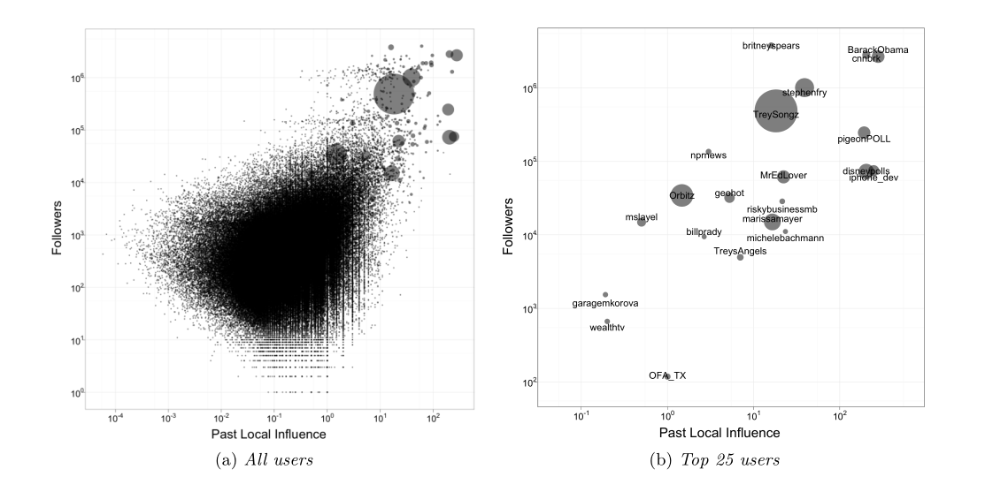
Necessary but not sufficient…
Bakshy, Eytan, et al. "Everyone's an influencer: quantifying influence on twitter." Proceedings of the fourth ACM international conference on Web search and data mining. ACM, 2011.

Slide 40
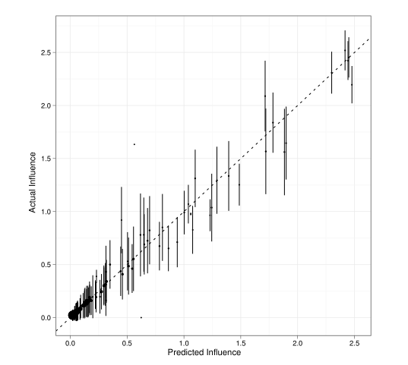
Content: A First Try
The authors also examined content based on 1000 manually encoded samples (selected in a manner stratified amongst the different sized cascades).
When added to the classification model, they actually caused a decrease in model fit.
Bakshy, Eytan, et al. "Everyone's an influencer: quantifying influence on twitter." Proceedings of the fourth ACM international conference on Web search and data mining. ACM, 2011.

Slide 41
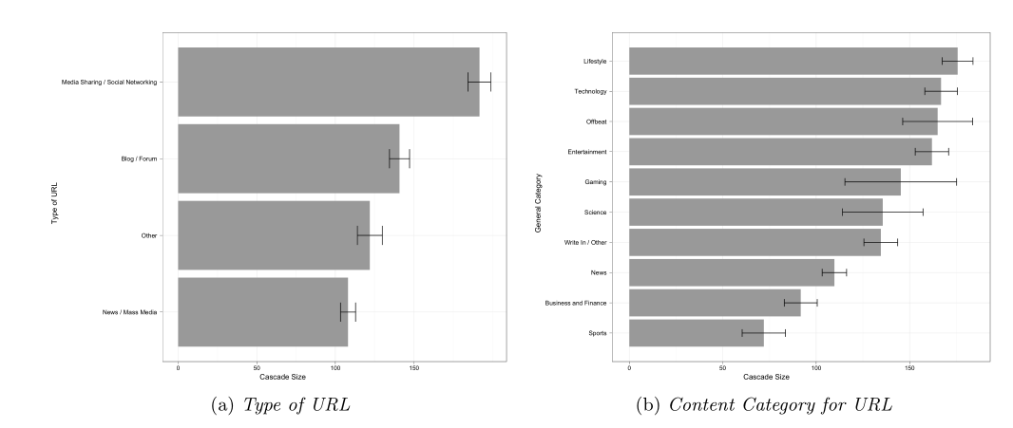
Content: A First Try
However, the categories themselves were interesting.
Bakshy, Eytan, et al. "Everyone's an influencer: quantifying influence on twitter." Proceedings of the fourth ACM international conference on Web search and data mining. ACM, 2011.

Slide 42
A Closer Look at Content
Jenders et al. (WWW 2013) also look at content as well as some aspects about the initial Twitter.
21.8M Original Tweets, 4.2M Retweetss
15K users
The examine the following features:
Number of followers
Tweet length
Hashtags
Mentions (mentioning other Twitter users)
Sentiment
Valence
Divergence
Positive-Negative Score Pairs

Slide 43
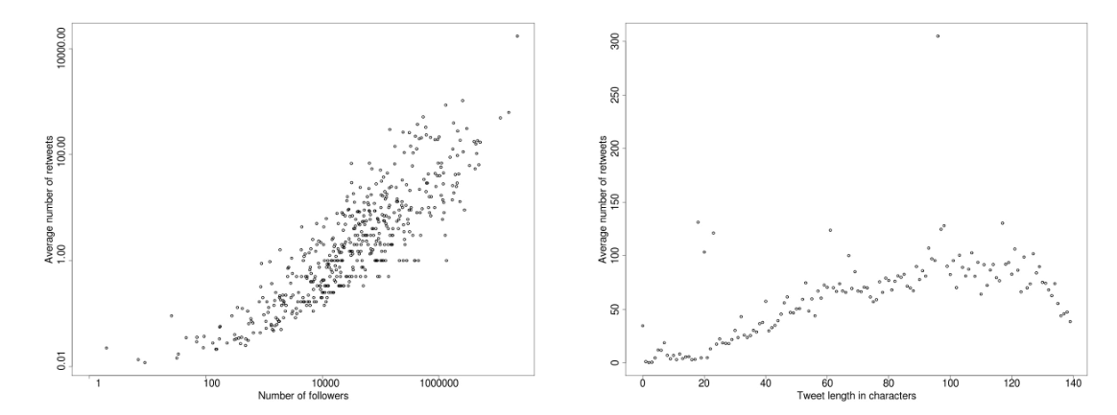
Followers and Tweet Length
Avg. number of retweets increases with number of followers
Avg. number of retweets increases with length until 120 characters, then decreases.
Jenders, Maximilian, Gjergji Kasneci, and Felix Naumann. "Analyzing and predicting viral tweets." Proceedings of the 22nd international conference on World Wide Web companion. International World Wide Web Conferences Steering Committee, 2013.

Slide 44
Sentiment
Based on an algorithm known as “SentiStrength” each Tweet has a positive and negative sentiment score.
Sentiment Valence: If the overall Tweet is predominantly positive or negative
Emotional Divergence: The absolute value of the difference between the two scores
Individual Sentiments: The actual positive-negative score pair.

Slide 45
Sentiment
Sentiment Valence: Probability of retweeting higher under the condition that the Tweet was primarily negative.
Emotional Divergence: Highly divergent Tweets often re-tweeted.
Individual Sentiments: (Next slide)

Slide 46
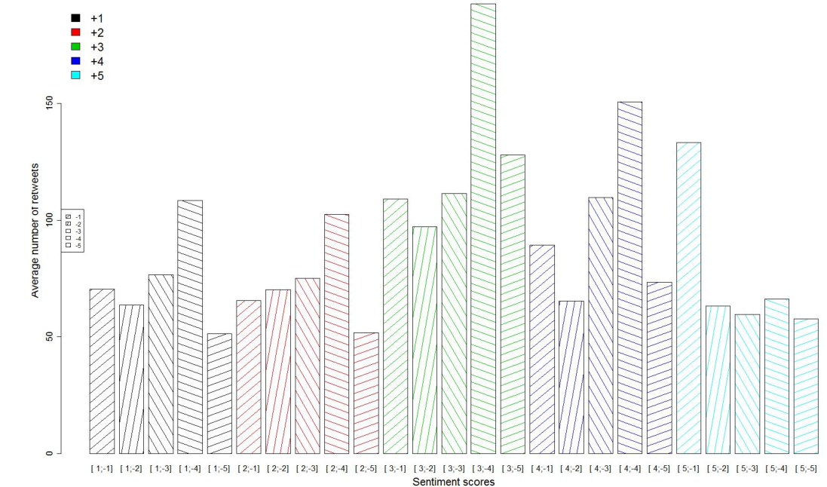
Sentiment Scores
Jenders, Maximilian, Gjergji Kasneci, and Felix Naumann. "Analyzing and predicting viral tweets." Proceedings of the 22nd international conference on World Wide Web companion. International World Wide Web Conferences Steering Committee, 2013.

Slide 47
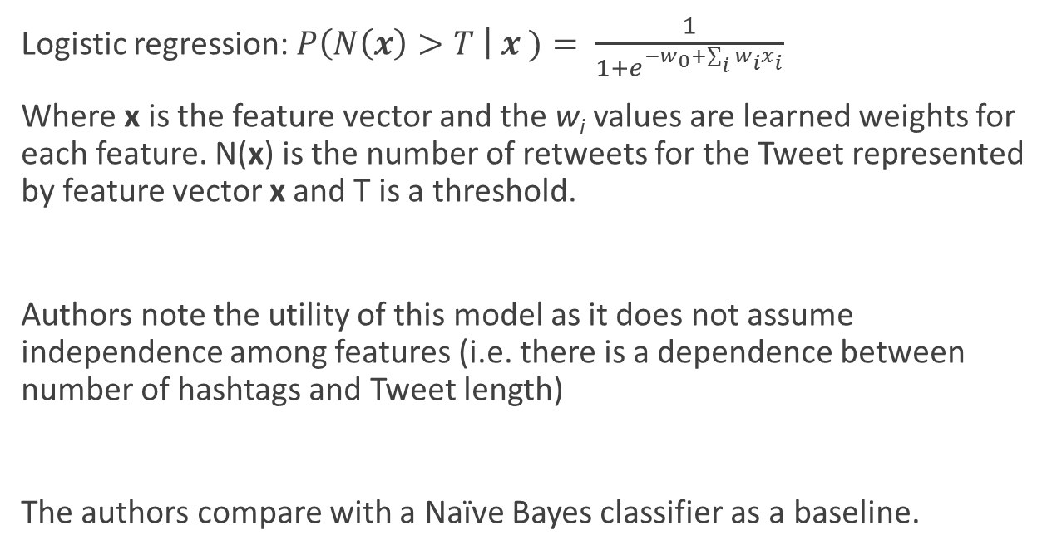
Classifiers
Logistic regression: $P\left(N\left(x\right)>T \right| x )= \frac{1}{1+e^{−w_{0}+\sum_{i}{w_{i}x_{i}}}}$
Where x is the feature vector and the w_{i} values are learned weights for each feature. N(x) is the number of retweets for the Tweet represented by feature vector x and T is a threshold.
Authors note the utility of this model as it does not assume independence among features (i.e. there is a dependence between number of hashtags and Tweet length)
The authors compare with a Naïve Bayes classifier as a baseline.

Slide 48
Experimental Setup
Authors note that their logistic model learns best when values from the feature vector are often repeated – hence feature values were discretized.
Ran different experiments where the parameter T was set to different values (50, 100, 500, 1000).
Cross-fold validation used, for each T value training and test sets were selected in a balanced manner (i.e. ½ Tweets retweeted greater than T times)

Slide 49
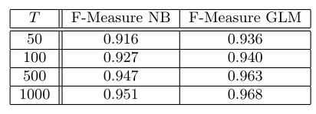
Results
High F1-scores on both Logistic and NB models; logistic out-performs NB.
However, note that the training and test sets were selected to be balanced.

Slide 50
Dealing with the Data Imbalance
Cheng et al. (WWW ‘14) are less selective in their training and test sets and accept the inherent data imbalance.
However, they look at a different query: given a cascade that has already started, can we predict when it will double in size?
Recall: cascade size is related to frequency by a power-law. Hence, predicting when a given cascade will exceed the median gives us a balanced binary classification problem. Further, if the cascade exceeds the median size, it has at least doubled.

Slide 51
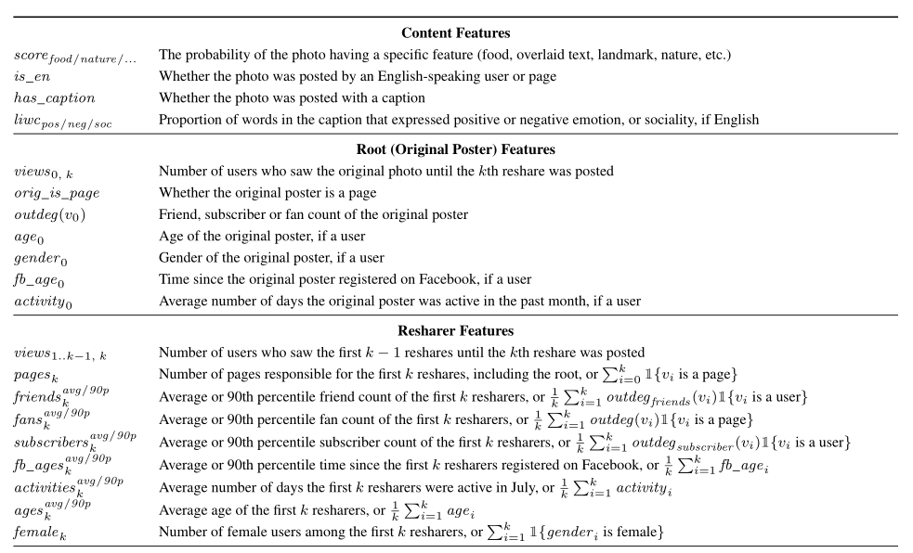
Features
Cheng, Justin, et al. "Can cascades be predicted?." Proceedings of the 23rd international conference on World wide web. International World Wide Web Conferences Steering Committee, 2014.

Slide 52
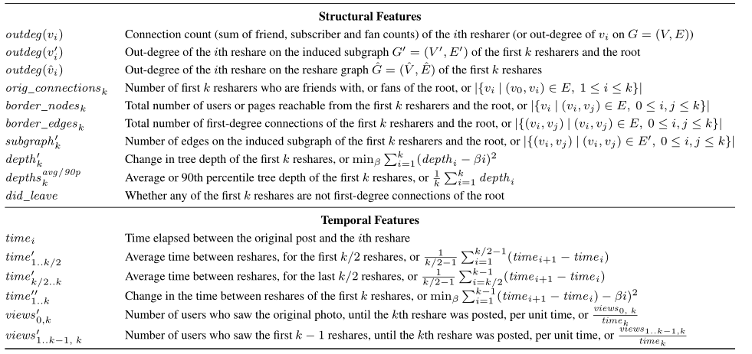
Features
Cheng, Justin, et al. "Can cascades be predicted?." Proceedings of the 23rd international conference on World wide web. International World Wide Web Conferences Steering Committee, 2014.

Slide 53
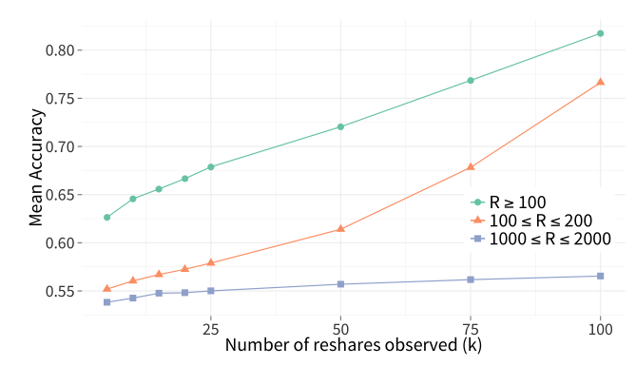
Sensitivity to Initially Observed Cascade
Cheng, Justin, et al. "Can cascades be predicted?." Proceedings of the 23rd international conference on World wide web. International World Wide Web Conferences Steering Committee, 2014.

Slide 54
Feature Importance
Some findings noted on the predicative ability of various features
Features based on averages were more predictive when the initial cascade was larger
The original post (followers of the seed node, how the content was posted) becomes a less important predictor when the initial cascade size is large
Content itself becomes a less important predictor as the initial cascade grows
Large cascades have a high conversion rate and grow quickly; importance of temporal features stable
Structure is important, but becomes less important over time (though reshare depth is highly correlated)

Slide 55
New Research
In our recent work, we develop features for order-of-magnitude cascade prediction (50 to 500 adopters).
Results are based on a Sina Weibo dataset that exhibits a power-law distribution.
A_{m}: New features
B_{m}: Previous state-of-the-art (Weng et al., 2014, ICWSM)
C_{m}: Baseline (average adoption time)
Numbers shown are for the viral class, under 2% of the samples (10-fold cross validation; error bars show 1× s.d.)
Guo, R., Shaabani, E., Bhatnagar, A., Shakarian, P., “Toward Order-of-Magnitude Cascade Prediction in Social Networks,”ASONAM, 2015.
Notes:
We identify cascades of size 50 that grow to size 500 with precision of 0.69 and recall of 0.52 (for the viral class, <2% of samples)
Analogous results for cascades that have progressed for 60 minutes
Demonstrate how to trade precision for recall allowing us to obtain precision of 0.78 or recall of 0.71 (at the expense of the other) for the viral class

Slide 56
Reference
Goyal, Amit, Francesco Bonchi, and Laks VS Lakshmanan. "Learning influence probabilities in social networks." Proceedings of the third ACM international conference on Web search and data mining. ACM, 2010.
Cheng, Justin, et al. "Can cascades be predicted?." Proceedings of the 23rd international conference on World wide web. International World Wide Web Conferences Steering Committee, 2014.
Bakshy, Eytan, et al. "Everyone's an influencer: quantifying influence on twitter." Proceedings of the fourth ACM international conference on Web search and data mining. ACM, 2011.
Guo, R., Shaabani, E., Bhatnagar, A., Shakarian, P., “Toward Order-of-Magnitude Cascade Prediction in Social Networks,” ASONAM, 2015.
Jenders, Maximilian, Gjergji Kasneci, and Felix Naumann. "Analyzing and predicting viral tweets." Proceedings of the 22nd international conference on World Wide Web companion. International World Wide Web Conferences Steering Committee, 2013.

